Slide 1


SARVAJINIK COLLEGE OF ENGINEERING AND TECHNOLOGY
Topic: Obscure Lock
Group Number: 11S1
Presented By: Akbari Darshit(160420107002)
Navadiya Keval (160420107031)
Roy Parth (160420107046)
Shah Dhruvi (160420107050)
Shreya Bohra (160420107054)
Guided By: Prof. Bhavesh Patel

Slide 2

OBSCURE LOCK
Never Off Guard

Slide 3
Problem Statement
In today’s world security is one of biggest aspect people look forward to whether it’s their family members protection or their precious valuables protection.
After having so many elementary solutions to the security problems,(like Intrusion Alarm, Hold-n-panic Alarm, CCTV etc.) there are lot of robbery reports been filed daily.
To improve the situations we have come up with new idea to protect your valuables.

Slide 4
Feasible Solution
“OBSCURE LOCK”
The “Obscure Lock ” is an augmented reality-based application which helps emporium possessor to embed the best of security to their stores with a virtual lock mechanism.

Slide 5
Project Description
This system will provide with virtual lock mechanism that can be used in any locker/safe/block of the showroom which will be operated using a Mobile Application. The mobile application will use camera and will pop pattern dots or numeral while facing the objects. You have to draw/write the correct pattern/numeral to unlock the Locker/safe/block which is under the surveillance of the “ OBSCURE LOCK App ”.
The block will open instinctively once the password/pattern is correctly entered. This functionality is performed using an IOT sensor and analyze weight inside the block/safe.
Another sort of functionality that is provided by the system is a chain of blocks between the user. The authentication of each user is accomplished using blockchain notion.

Slide 6
SOFTWARE REQUIREMENT SPECIFICATION

Slide 7
This SRS(Software Requirement Specification) document is intended to provide the complete overview of obscure lock mechanism, user interface and story within.

Slide 8
Product Perspective
The fundamental attribute of our system which builds the system
Wall Scanning
User Authentication
Weighing Technology
Transaction Tracing

Slide 9
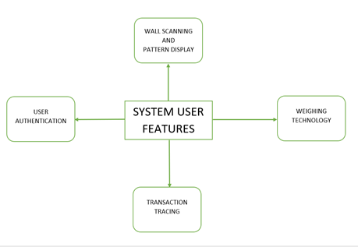

Slide 10
WALL SCANNING
USER AUTHENTICATION
Every individual who is a part of the system is provided with a user substantiation password which is noticeable only when user keep their mobile phones facing the walls.
When a particular individual whose is a responsible handler of the system keeps there mobile facing the walls a scanning takes place to examine the wall is under the surveillance of our system.

Slide 11
TRANSACTION TRACING
Once a user tries to keep something or take out anything from the safe weight of the safe is calculated and recorded each time.
WEIGHING TECHNOLOGY
Each time a executive tries to open the safe the transaction of him opening and closing the doors of the safe is recorded and the weight of the safe is recorded each time.

Slide 12
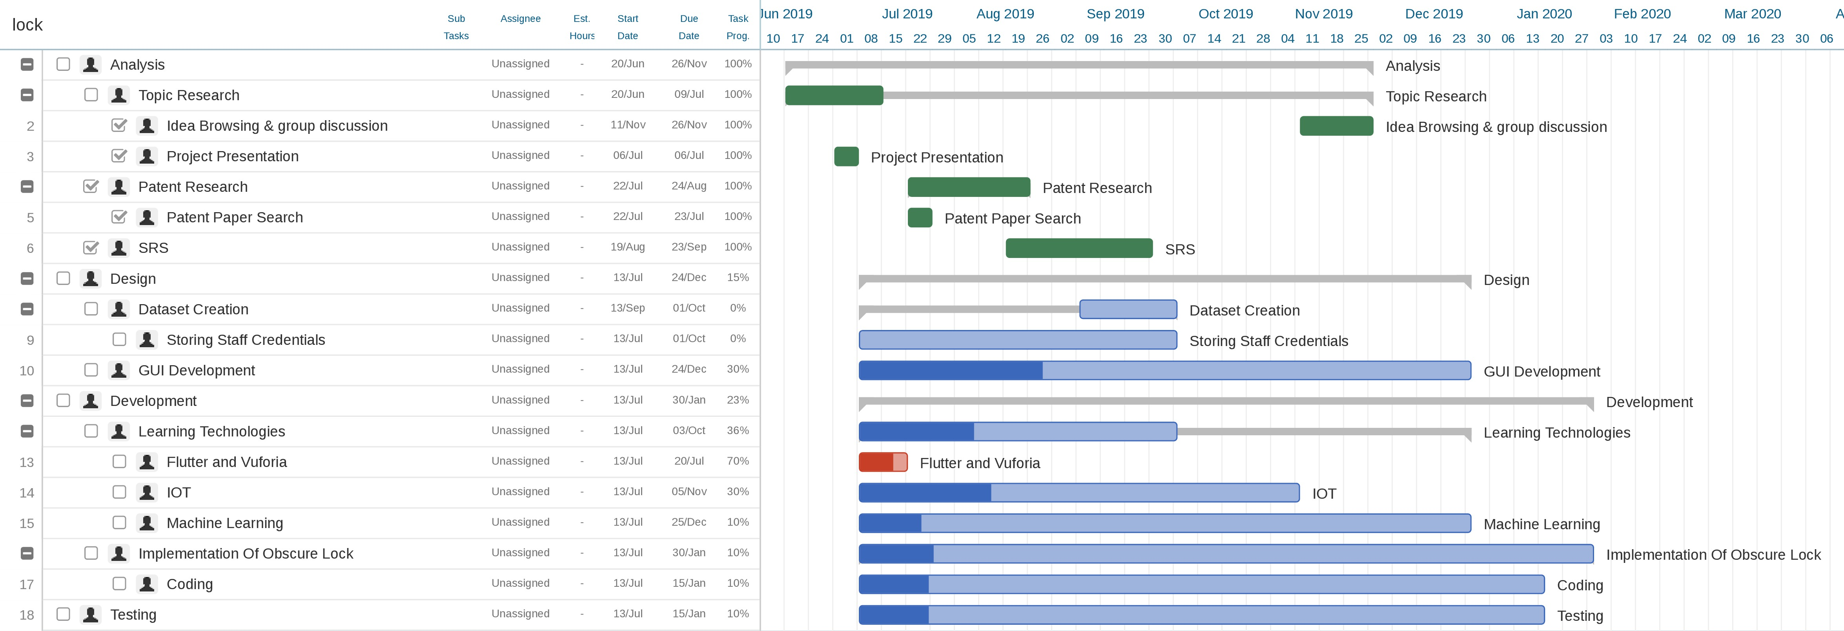
GANTT CHART

Slide 13
Technology Stack
Back End software’s
Front End software's
Software Parts | Description
Operating System | Windows/Linux
Database | Firebase
Languages | Description | Part of the system using it
Vuforia | For Augmented Reality | To pop pattern on the phone
Ethereum IDE | Blockchain | Trace each transaction of staff
Flutter | IOS and Android Apps | To develop the application
Deep Learning | Wall Scanning | To scan the wall under obscure lock security

Slide 14
Hardware Required
Weighing Sensors
Mobile Phones
Ardino ESP8266

Slide 15
USER INTERACTION

Slide 16
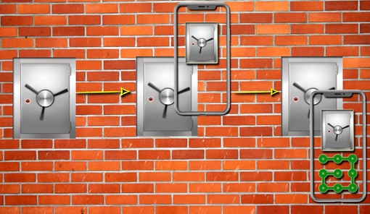
Wall Scanning

Slide 17
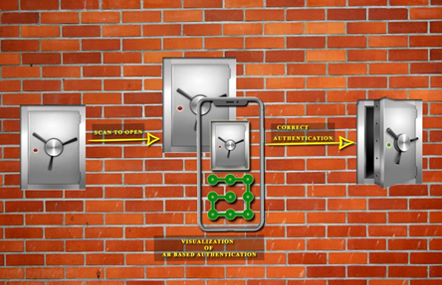
Safe Opens

Slide 18
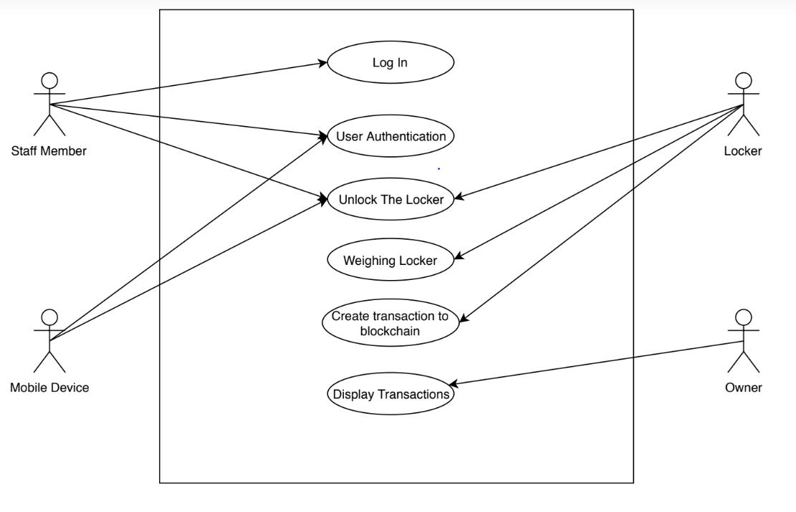
USE-CASE DIAGRAM

Slide 19
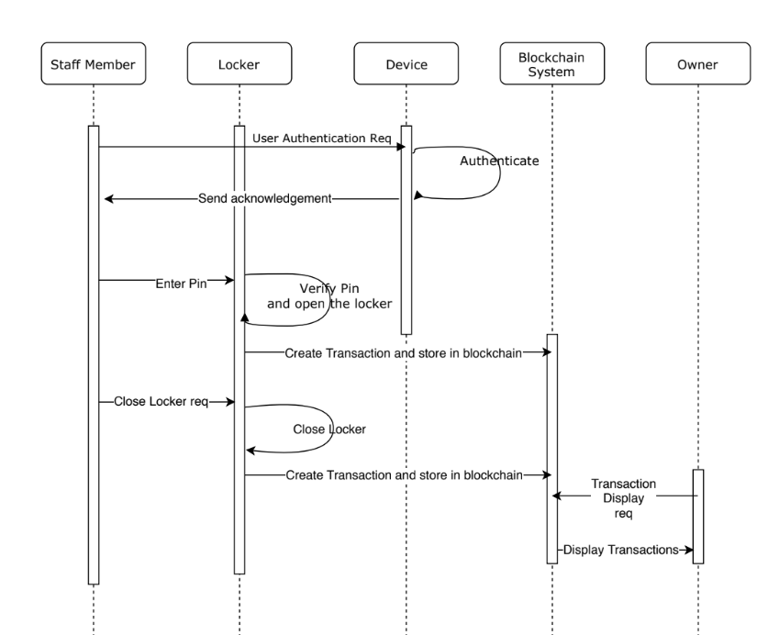
SEQUENCE DIAGRAM

Slide 20
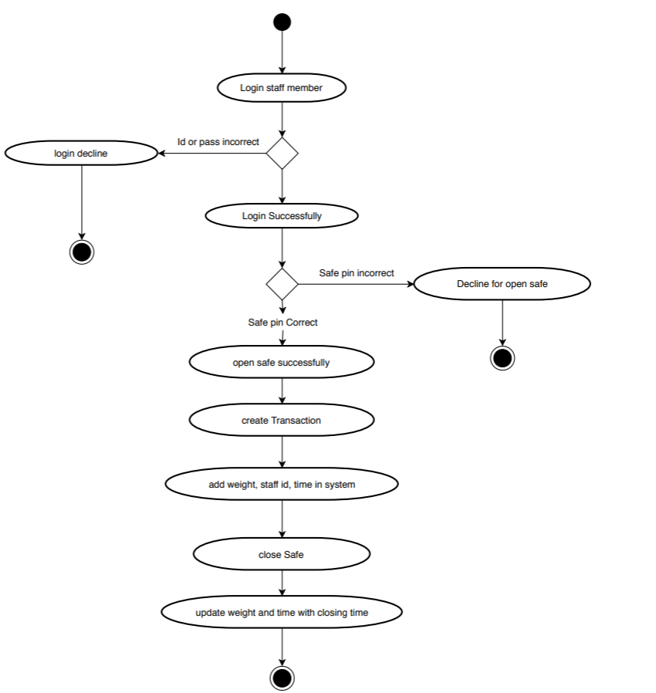
ACTIVITY DIAGRAM

Slide 21
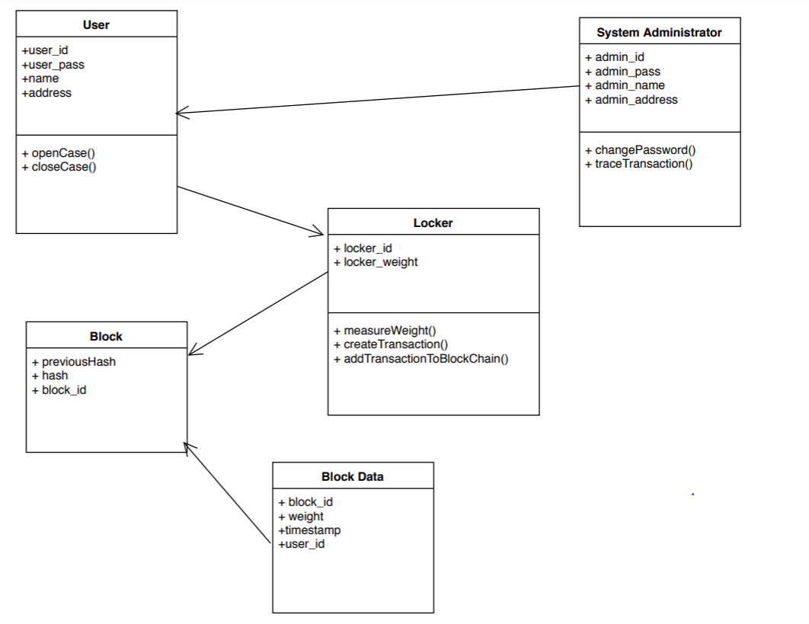
DATABASE DESIGN

Slide 22
References
https://www.youtube.com/watch?v=u8njnXc7ziY&t=15s
https://www.hackster.io/search?q=iot%20automated%20door%20open&i=projects
https://www.connectbit.com/blockchain-applications/

Slide 23

THANK YOU

